Slide 1

Association Rule Mining
Dr. Faisal Kamiran
DR. FAISAL KAMIRAN
INFORMATION TECHNOLOGY UNIVERSITY

Slide 2
FP-growth Algorithm
Use a compressed representation of the database using an FP-tree
Once an FP-tree has been constructed, it uses a recursive divide-and-conquer approach to mine the frequent itemsets
Steps:
  FP tree construction
  Conditional pattern base construction
  Conditional FP-trees
  Frequent pattern generation
Dr. Faisal Kamiran Information Technology University of The Punjab

Slide 3
FP-Tree Construction
TID Items bought (ordered) frequent items
100 {f, a, c, d, g, i, m, p} {f, c, a, m, p}
200 {a, b, c, f, l, m, o} {f, c, a, b, m}
300 {b, f, h, j, o, w} {f, b}
400 {b, c, k, s, p} {c, b, p}
500 {a, f, c, e, l, p, m, n} {f, c, a, m, p}
min_support = 3
F-list = f-c-a-b-m-p
{}
{}
{}
{}
f:2
f:3
c:1
f:1
f:3
c:2
c:2
b:1
b:1
c:1
c:2
b:1
a:2
a:2
p:1
a:1
a:2
m:1
b:1
m:1
b:1
m:1
m:1
b:1
p:1
m:1
p:1
m:1
p:1
p:1
m:1
Dr. Faisal Kamiran Information Technology University of The Punjab

Slide 4
FP-Tree Construction
TID Items bought (ordered) frequent items
100 {f, a, c, d, g, i, m, p} {f, c, a, m, p}
200 {a, b, c, f, l, m, o} {f, c, a, b, m}
300 {b, f, h, j, o, w} {f, b}
400 {b, c, k, s, p} {c, b, p}
500 {a, f, c, e, l, p, m, n} {f, c, a, m, p}
min_support = 3
{}
Header Table
Item frequency head
f 4
c 4
a 3
b 3
m 3
p 3
Scan DB once, find frequent 1-itemset (single item pattern)
Sort frequent items in frequency descending order, f-list
Scan DB again, construct FP-tree
f:4
c:1
c:3
b:1
b:1
a:3
p:1
m:2
b:1
F-list = f-c-a-b-m-p
p:2
m:1
Dr. Faisal Kamiran Information Technology University of The Punjab

Slide 5
Partition Patterns and Databases
Frequent patterns can be partitioned into subsets according to f-list
  F-list = f-c-a-b-m-p
  Patterns containing p
  Patterns having m but no p
  …
  Patterns having c but no a nor b, m, p
  Pattern f
Completeness and non-redundency
Dr. Faisal Kamiran Information Technology University of The Punjab

Slide 6
Conditional Pattern Base Construction
Conditional Pattern Base is a sub-database which consists of the set of prefix paths in the FP tree co-occurring with the suffix pattern or item. For example prefix paths (fcam, cb) of item p to form p’s conditional pattern base.
{}
Header Table
Item frequency head
f 4
c 4
a 3
b 3
m 3
p 3
f:4
c:1
Conditional pattern bases
item cond. pattern base
c f:3
a fc:3
b fca:1, f:1, c:1
m fca:2, fcab:1
p fcam:2, cb:1
c:3
b:1
b:1
a:3
p:1
m:2
b:1
p:2
m:1
Dr. Faisal Kamiran Information Technology University of The Punjab

Slide 7
From Conditional Pattern-bases to Conditional FP-trees
For each pattern-base
  Accumulate the count for each item in the base
  Construct the FP-tree for the frequent items of the pattern base
m-conditional pattern base:
  fca:2, fcab:1
{}
Header Table
Item frequency head
f 4
c 4
a 3
b 3
m 3
p 3
f:4
c:1
All frequent patterns relate to m
m,
fm, cm, am,
fcm, fam, cam,
fcam
{}
c:3
b:1
b:1

f:3

a:3
p:1
m:2
b:1
c:3
p:2
m:1
a:3
min_support = 3
m-conditional FP-tree
Dr. Faisal Kamiran Information Technology University of The Punjab

Slide 8
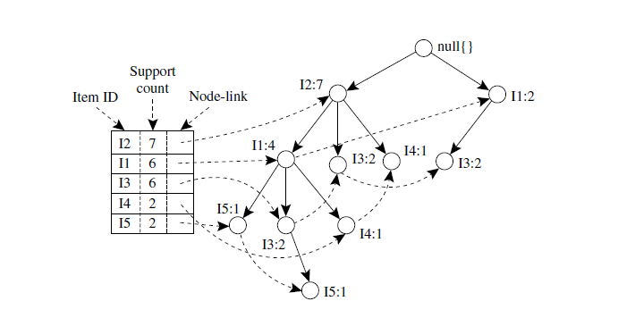
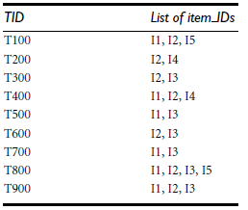
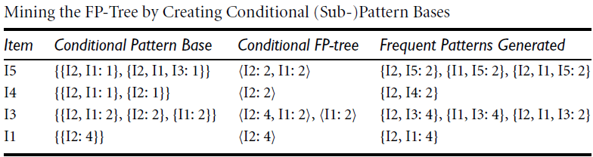
FP Growth: Example
Min supp=2
FP Tree:
Data:
Dr. Faisal Kamiran Information Technology University of The Punjab

Slide 9
Benefits of the FP-tree Structure
Completeness
  Preserve complete information for frequent pattern mining
  Never break a long pattern of any transaction
Compactness
  Reduce irrelevant info—infrequent items are gone
  Items in frequency descending order: the more frequently occurring, the more likely to be shared
  Never be larger than the original database (not count node-links and the count field)
Dr. Faisal Kamiran Information Technology University of The Punjab

Slide 10
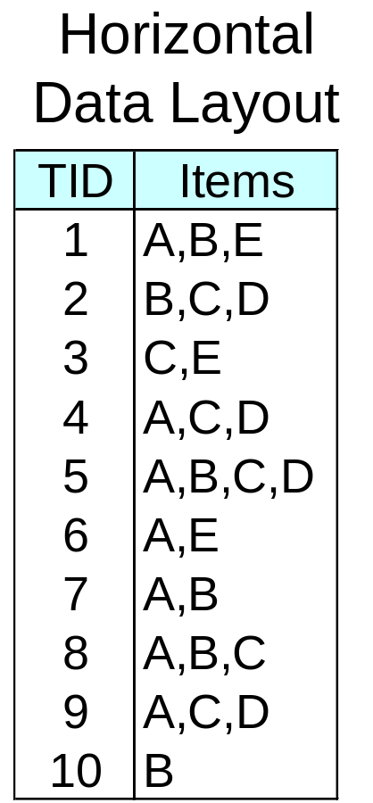
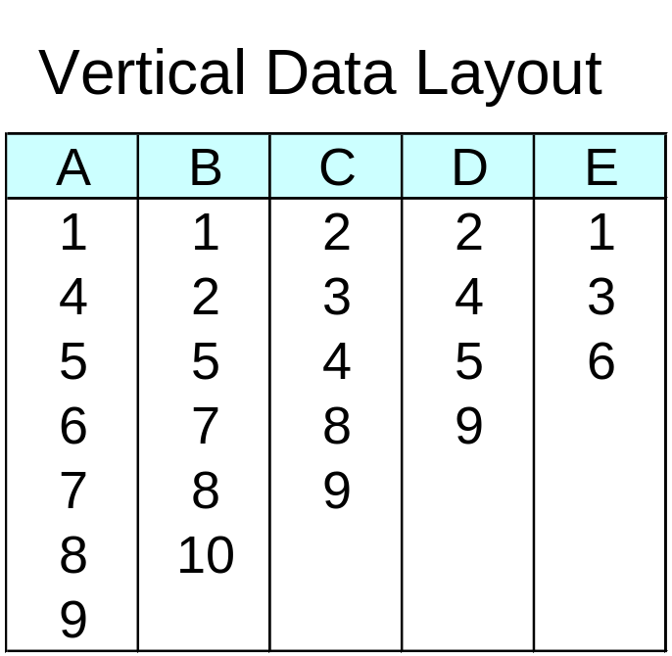
ECLAT
For each item, store a list of transaction ids (tids)
TID-list
Dr. Faisal Kamiran Information Technology University of The Punjab

Slide 11
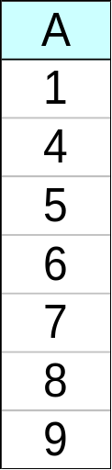
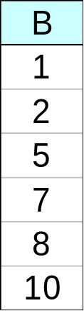
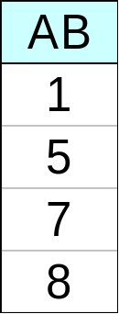
ECLAT
Determine support of any k-itemset by intersecting tid-lists of two of its (k-1) subsets.
3 traversal approaches:
  top-down, bottom-up and hybrid
Advantage: very fast support counting
Disadvantage: intermediate tid-lists may become too large for memory
∧
→
Dr. Faisal Kamiran Information Technology University of The Punjab

Slide 12
Rule Generation
Given a frequent itemset L, find all non-empty subsets f ⊂ L such that f → L – f satisfies the minimum confidence requirement
  If {A,B,C,D} is a frequent itemset, candidate rules:
    ABC →D, ABD →C, ACD →B, BCD →A,
    A →BCD, B →ACD, C →ABD, D →ABC
    AB →CD, AC → BD, AD → BC, BC →AD,
    BD →AC, CD →AB,
If |L| = k, then there are 2^{k} – 2 candidate association rules (ignoring L → ∅ and ∅ → L)
Dr. Faisal Kamiran Information Technology University of The Punjab

Slide 13
Rule Generation
How to efficiently generate rules from frequent itemsets?
  In general, confidence does not have an anti-monotone property
    c(ABC →D) can be larger or smaller than c(AB →D)
  But confidence of rules generated from the same itemset has an anti-monotone property
  e.g., L = {A,B,C,D}:
  c(ABC → D) ≥ c(AB → CD) ≥ c(A → BCD)
Dr. Faisal Kamiran Information Technology University of The Punjab

Slide 14
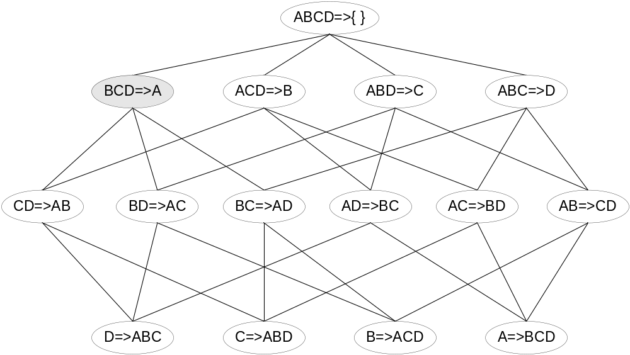

Rule Generation for Apriori Algorithm
Lattice of rules
Low Confidence Rule
Pruned Rules
Dr. Faisal Kamiran Information Technology University of The Punjab

Slide 15
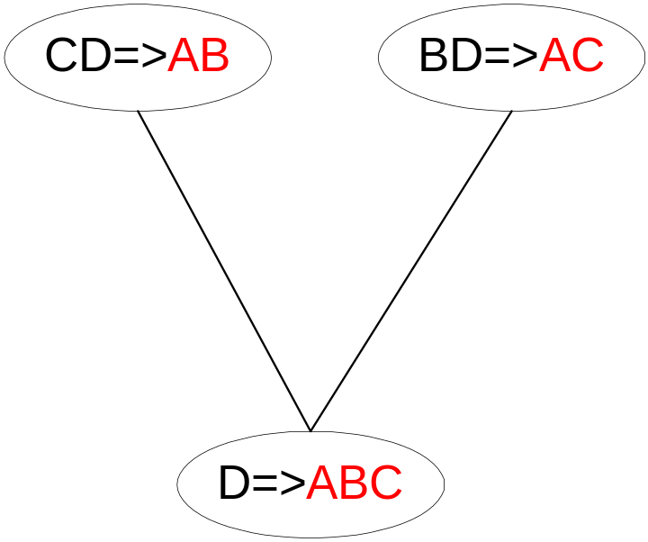
Rule Generation for Apriori Algorithm
Candidate rule is generated by merging two rules that share the same prefix
in the rule consequent
join(CD=>AB,BD=>AC)
would produce the candidate
rule D => ABC
Prune rule D=>ABC if its
subset CD=>AB does not have
high confidence
Dr. Faisal Kamiran Information Technology University of The Punjab

Slide 16
Pattern Evaluation
Association rule algorithms tend to produce too many rules
  many of them are uninteresting or redundant
  Redundant if {A,B,C} → {D} and {A,B} → {D}
  have same support & confidence
Interestingness measures can be used to prune/rank the derived patterns
In the original formulation of association rules, support & confidence are the only measures used
Dr. Faisal Kamiran Information Technology University of The Punjab

Slide 17
Computing Interestingness Measure
Given a rule X → Y, information needed to compute rule interestingness can be obtained from a contingency table
Contingency table for X → Y
 | Y | Y
X | f₁₁ | f₁₀ | f₁₊
X | f₀₁ | f₀₀ | f_{o+}
 | f₊₁ | f₊₀ | |T|
f₁₁: support of X and Y
f₁₀: support of X and Y
f₀₁: support of X and Y
f₀₀: support of X and Y
Used to define various measures
support, confidence, lift, Gini,
J-measure, etc.
Dr. Faisal Kamiran Information Technology University of The Punjab

Slide 18
Drawback of Confidence
 | Coffee | Coffee
Tea | 15 | 5 | 20
Tea | 75 | 5 | 80
 | 90 | 10 | 100
Association Rule: Tea → Coffee
Confidence= P(Coffee|Tea) = 0.75
but P(Coffee) = 0.9
Although confidence is high, rule is misleading
P(Coffee|Tea) = 0.9375
Dr. Faisal Kamiran Information Technology University of The Punjab

Slide 19
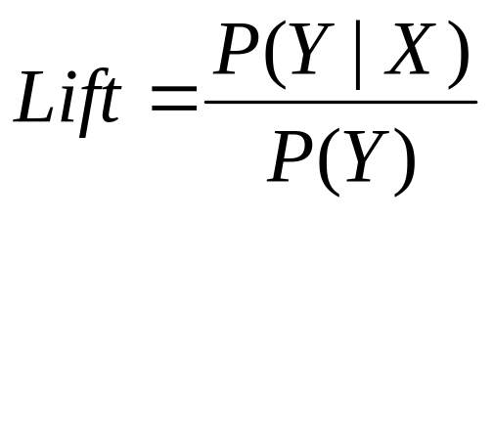
Statistical-based Measures
Measures that take into account statistical dependence
Dr. Faisal Kamiran Information Technology University of The Punjab

Slide 20
Example: Lift/Interest
 | Coffee | Coffee
Tea | 15 | 5 | 20
Tea | 75 | 5 | 80
 | 90 | 10 | 100
Association Rule: Tea → Coffee
Confidence= P(Coffee|Tea) = 0.75
but P(Coffee) = 0.9
Lift = 0.75/0.9= 0.8333 (< 1, therefore is negatively associated)
Dr. Faisal Kamiran Information Technology University of The Punjab

